Slide 1
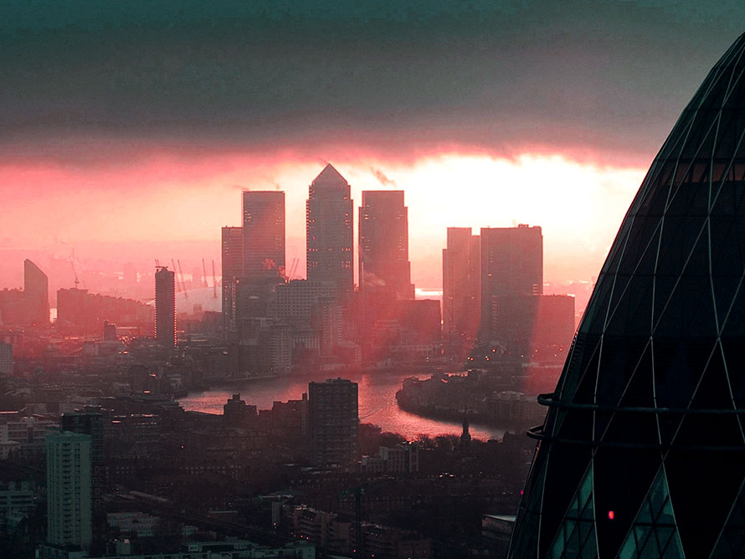

Perceived Risk of Particulate Episodes
By Mostyn Wood

Slide 2
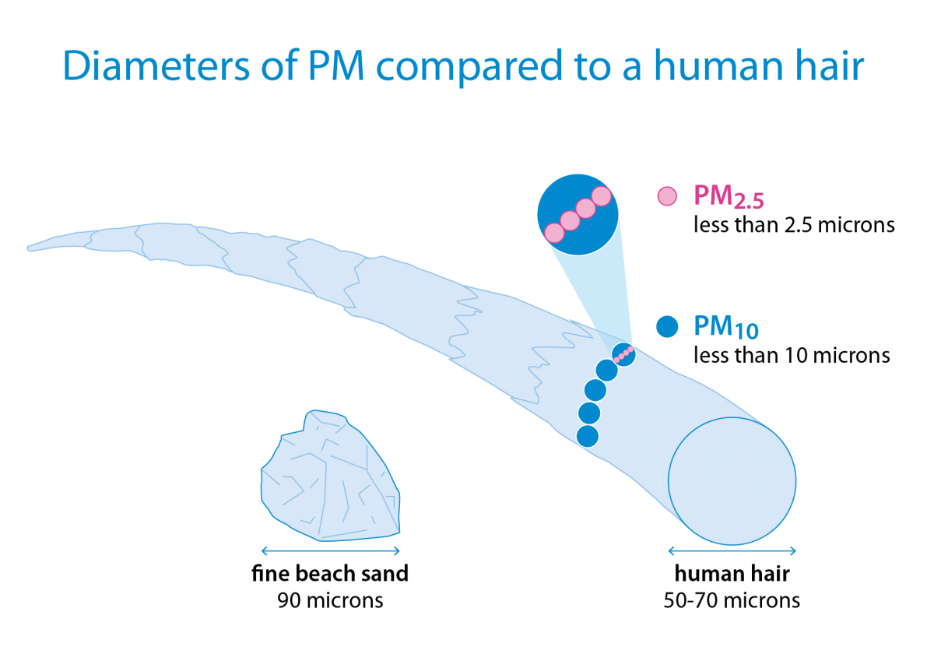
Introduction
A particulate episode is a period of high PM10 and PM2.5 concentration resulting in poor air quality.
PM10 and PM2.5 are particulate matter of diameters less than 10 and 2.5 microns.
PM10 mostly caught in the nose. PM2.5 can reach the breathing sacs deep in your lungs and cause hospitalisations.
credit: The British Lung Foundation. Types of air pollutants | British Lung Foundation (blf.org.uk)

Slide 3
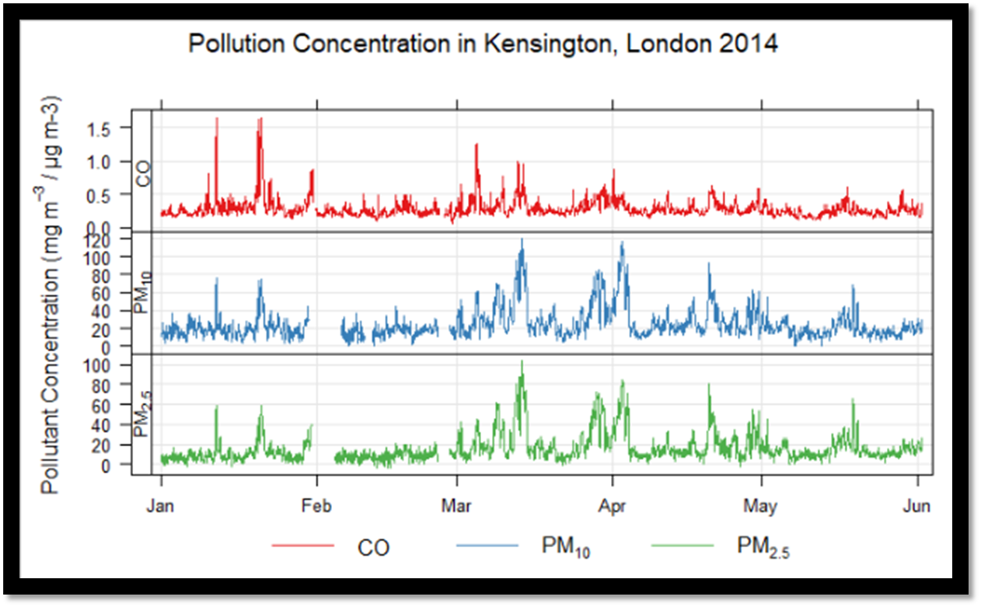

Introduction
One spring particulate episode in March/April 2014 received great publicity due to the involvement of transported Saharan Dust.
Two episodes from March-April caused ~600 deaths and ~1500 hospitalizations across the UK. [1]
Here we look to explore the causes, effects, possible mitigation and public perception of particulate episodes in the UK.

Slide 4
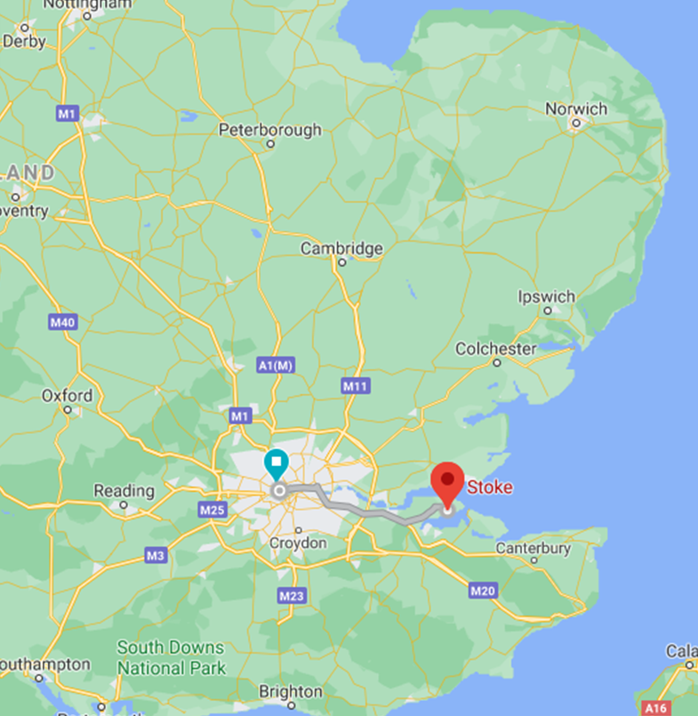
Methods
Using the statistical computing language R and its package Openair
Model the meteorology and pollution around the UK and Europe.
All data is opensource and collected by DEFRA via AURN.
We will be using PM10, PM2.5 as well NOX and NO2.
Sites we will investigate include Kensington, London and Rochester Stoke which are Urban and Rural Background sites in south-east England.
Two episode of interest are March/April 2014 and late-April 2011.
We will be referencing the official DEFRA annual report for guidance on the effects of meteorology on the pollution

Slide 5
Methods
Function plots that I will use:
timePlot – graphs pollutant concentration by time
pollutionRose – presents wind direction, speed and transported pollutants
windVector timePlot – timeplot with wind direction and magnitude
Hysplit – models long pollution transport

Slide 6
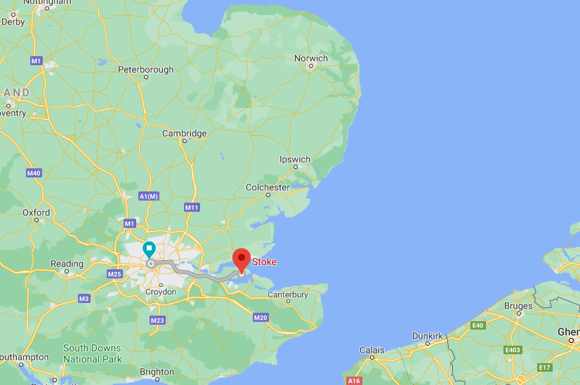
Data

Slide 7
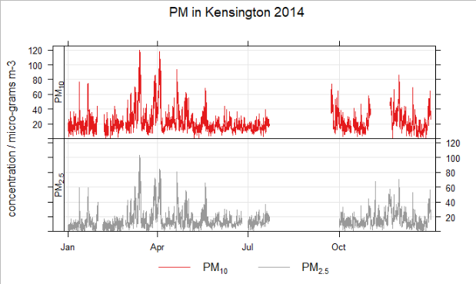


Slide 8
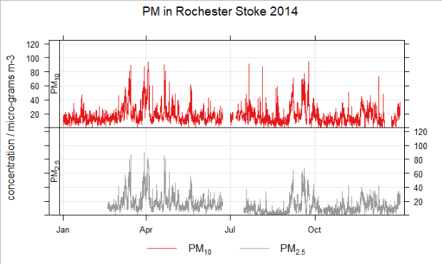

Slide 9
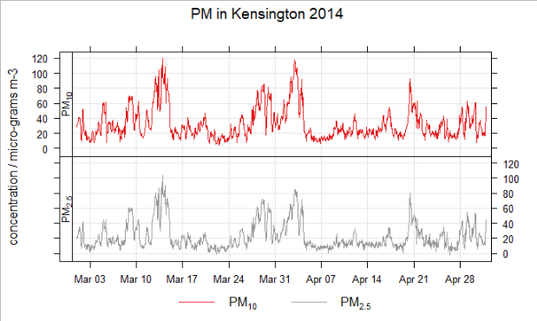

Slide 10
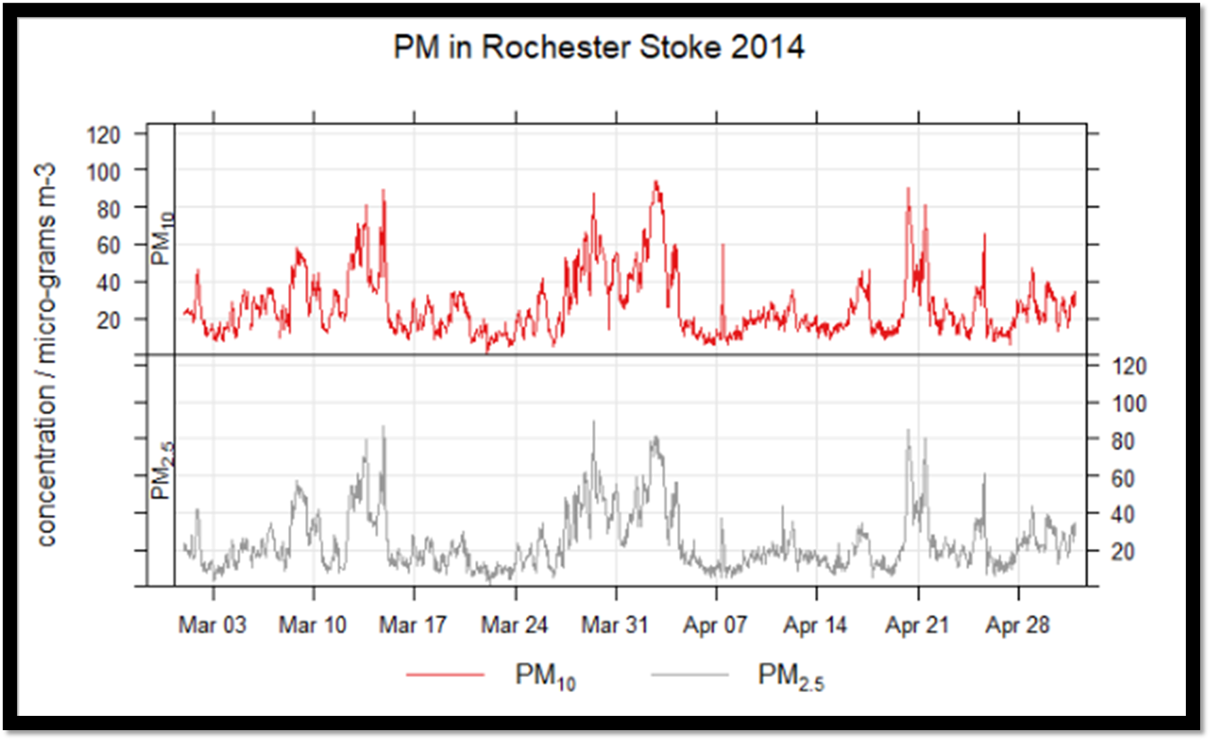

Slide 12
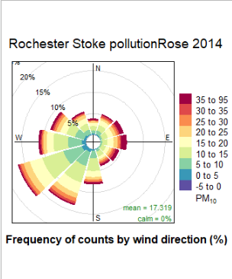
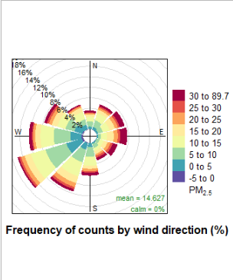
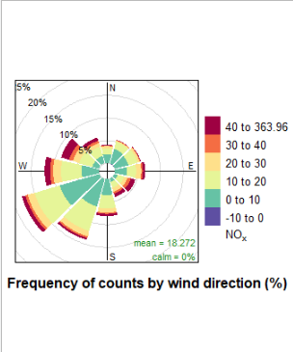
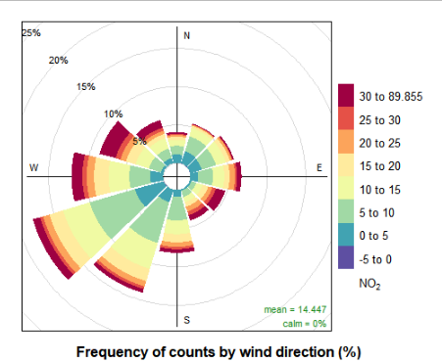

Slide 13
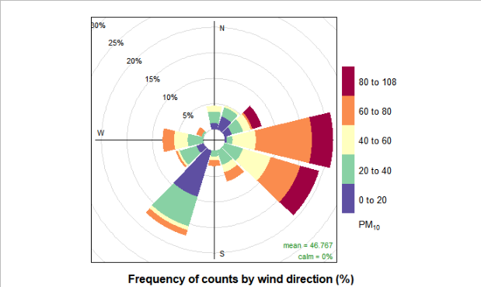

Slide 14
what caused the episode? reference the DEFRA report + wind vector graph
Data
28th March: Easterly wind brought polluted air mass from Europe.
29th March: Combined with a calm sunny day, trapping local pollution.
30th March: A slight increase in southerly wind speed decreased pollution levels in the south and increased them in the north.
31st March: An air mass which had travelled up through France via the Sahara arrived in the UK. The polluted air mass travelled north throughout the day.
31st March – 3rd April: A light southerly wind brought urban and industrial pollution from France arrived in the UK Throughout the episode exhaust emissions, both continental and local, were identified as a major component of the pollution.
3rd April: Overnight, light winds from the Atlantic started to slowly disperse the pollution.
4th April: Particulate pollution levels returned to ‘low’ throughout the UK.
Defra Report day by day
just Kensington? just more pollution?
splitting into two, 27/4 to 31st and 31st to 4th

Slide 15
hysplit!
look its from Europe but hang on. I thought there was sahardan dust? barely!
sahardan dust is pm10?? so not very effective in damaging health, however the public were fascinated and took interest because the episode was physical / visable

Slide 16
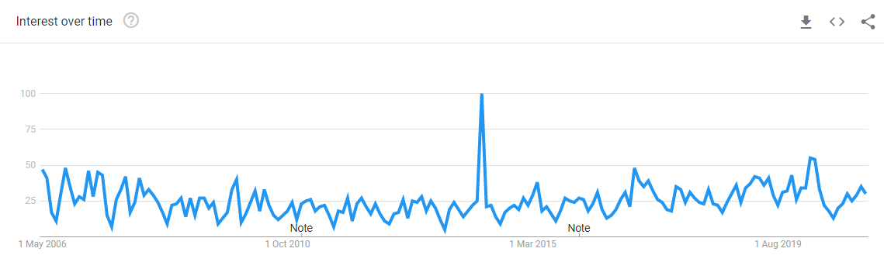
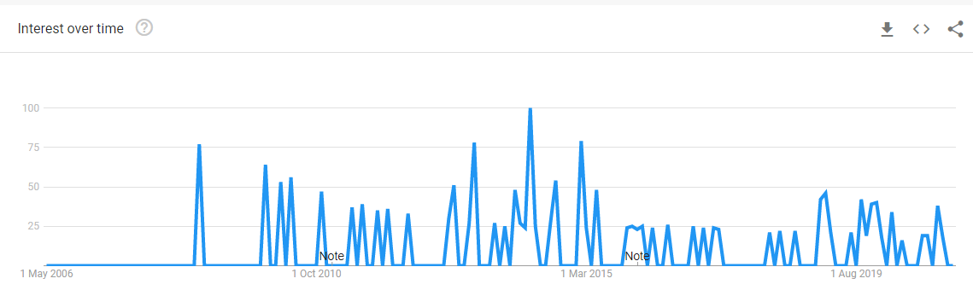
“Air Pollution”
“Air Pollution effects on health”

Slide 17
?
“Air Pollution”
“Air Pollution effects on health”

Slide 18
2011 pollution episode
not as much publicity bc no saharan dust?
less public concern even though tho it was worse that the 2014 event

Slide 19
discussion
Using observed levels of PM_{2.5} from other years, we estimate that this is 2.0 to 2.7 times the mortality burden associated with typical urban background levels of PM_{2.5} at this time of year.

Slide 20
conclusion
Helen L. Macintyre, Clare Heaviside, Lucy S. Neal, Paul Agnew, John Thornes, Sotiris Vardoulakis,
Mortality and emergency hospitalizations associated with atmospheric particulate matter episodes across the UK in spring 2014,
Environment International,
Volume 97,
2016,
Pages 108-116,
ISSN 0160-4120,
https://doi.org/10.1016/j.envint.2016.07.018.
(https://www.sciencedirect.com/science/article/pii/S0160412016302847)

Slide 21
Notes
Windvectors y-axis label incorrect
Hoping for leeds southern winds on pollution roses
leeds seems a waste on time, adds nothing
would rural be worth doing?
what is my aim? evaluation of defra report? transport vs local?
how do you find what % is local and what is transported? look at local pollutants?
no evidence of a calm sunny day

